Slide 1
CSCI-111
Lecture 1
Nick Rugai PhD

Slide 2
The Logical Thinking
Most animals think.
Humans think.
Computers think.
Humans can think illogically.
Computers think logically.

Slide 3
The way of the program
You become a Computer Scientist, the moment you find yourself thinking like a computer does.
It is pure logical enlightenment.
It will make you a problem solver.
The issues related to incoherent animal thinking can be explained via Popper’s three world view.

Slide 4
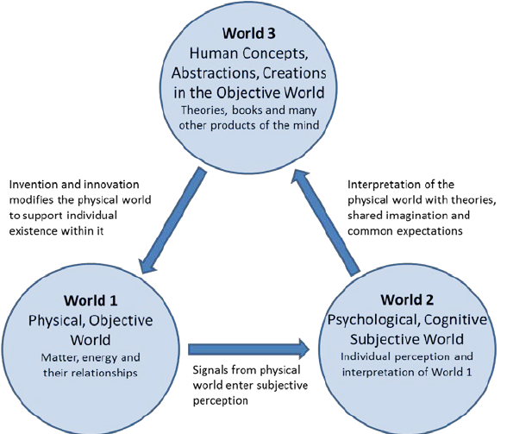
Karl Popper’s Three Worlds
TRUTH

Slide 5
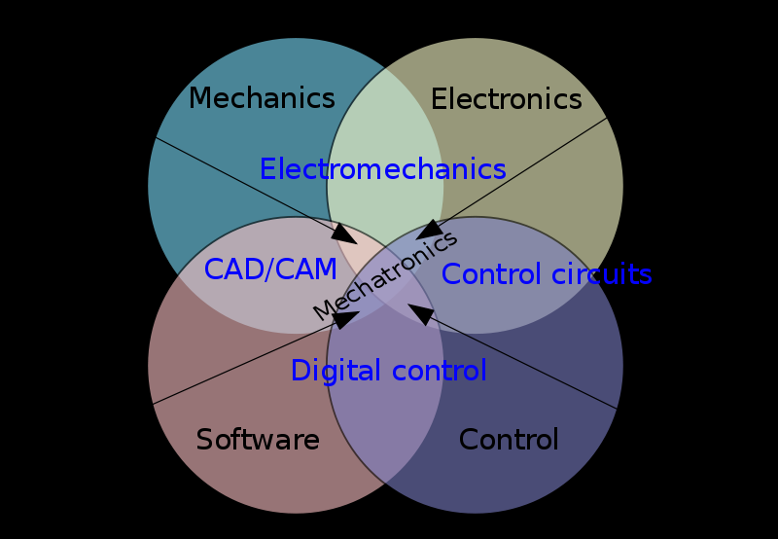
Computers also seek Truth

Slide 6
What is a Computer?
A computer is a machine that can perform operations.
The brain is an organ that can perform operations.
The computer needs parts:
Hardware
Peripherals
Inter-connectivity
Software

Slide 7
Hardware
Long term memory:
Hard-drives, memory sticks, CDs, etc.
Short term memory:
RAM
Computer Chips
Circuit boards
Power supplies

Slide 8
Peripherals
Monitors
Keyboard
Cameras
Mic
Speakers
Lights
Moving arms
MORE!

Slide 9
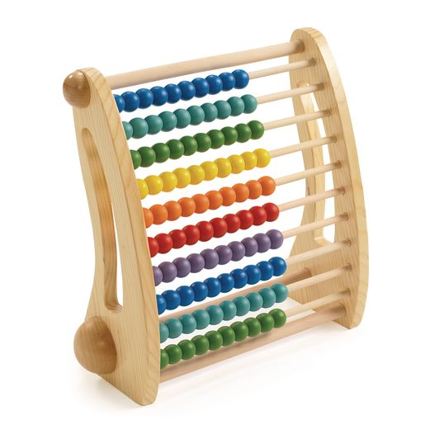
Computer History
2400 BC Abacus
200 BC Astrolabe
1620 AD Side Rule
1872 Analog Computer
1888 Mechanical Computer
1936 The Idea of the Modern Computer
1938 Electromagnetic Computer
1955 Transistors replaced Vacuum Tubes
1958 Integrated Circuit, ‘chip’

Slide 10
Internet
1969 ARPANET
1973 Satellite Connection
1982 Public Access
1990 The Internet

Slide 11
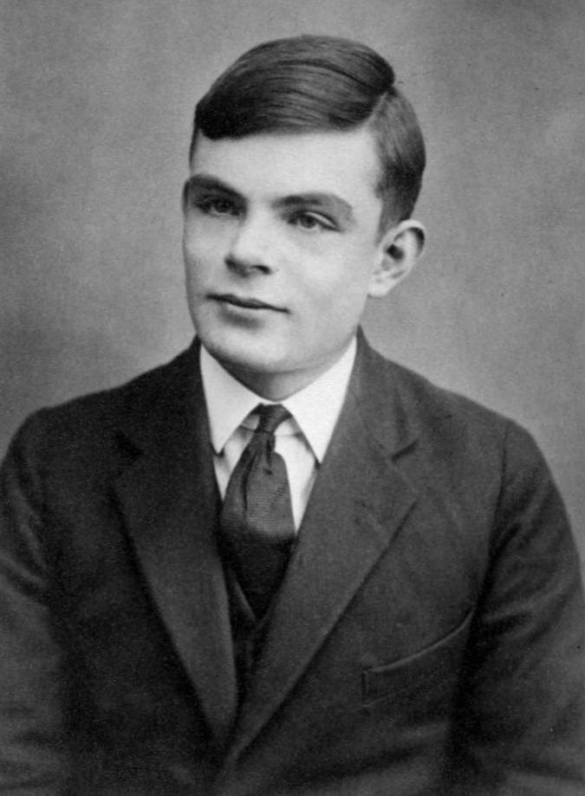
The Modern Computer
Alan Turing (1912-1954).
Universal Computing Machine.
Universal Turing Machine.
Computing anything that is computable.
Read, Write, Store.
Can solve all problems a supercomputer can.

Slide 12
Universal Turing Machine
Does a machine M1 exist that can determine whether any arbitrary machine M2 run on M1 accomplishes its task or freezes/run infinite loop?
Does a machine M1 exist that can determine whether any arbitrary machine M2 run on its tape ever prints a given symbol?
Turing proved the answer to both statements is NO!
Turing showed the limitations of modern computers before they were created!
His findings still stand given the most modern supercomputer or even a quantum computer!

Slide 13
Software
A program is a sequence of instruction on how to perform a computation.
Input: Keyboard, Files, Network…
Output: Monitor, Storing Devices…
Math: Logical Operations.
Conditional Executions: The rules and code, the algorithm:
Finite sequence of well-defined instructions to solve a problem.
Repetition: Perform actions repeatedly with possible variation:
This is where computers excel vs. humans.

